Slide 1

PLACEMENT ELIGIBILITY
MANAGEMENT SYSTEM
A Menu-Driven C Application Using Structures & File Handling
TEAM MEMBERS
Jeevan. S
Kamalesh. P
Livin Amalraj. A
811325104088
811325104091
811325104110

Slide 2



ABSTRACT
Project Abstract
The Placement Eligibility Management System is a menu-driven C program built with structures and text file handling to manage student placement records, letting users add, view, search, and store student details efficiently.
Structured & Efficient
Add, view, search, and store details with ease
File-Based Storage
Eligibility is checked automatically against CGPA, attendance, and arrears, with every qualifying student displayed at once — giving a simple, organized way to maintain student information while reinforcing structures, functions, and file handling in C.
Structures & text file handling keep records safe
Eligibility Checks
Evaluates CGPA, attendance & arrears automatically
Team Marvels — Jeevan S · Kamalesh P · Livin Amalraj A
2

Slide 3


INTRODUCTION
Why This Project?
Campus placements require accurate tracking of each student's academic and technical profile. Manually checking every student against a company's eligibility criteria is slow and error-prone.
Fast & Reliable
Instant eligibility checks, no manual paperwork
This project builds a simple, menu-driven console system in C that stores student records using structures, saves them to a file for safekeeping, and instantly reports who qualifies for placement drives.
Persistent Storage
Records saved to a file — nothing is lost on exit
Clear Decisions
Automatic ELIGIBLE / NOT ELIGIBLE status
3

Slide 4
DESIGN
The Student Structure
Every student record — including contact and academic details — is grouped into a single C structure.
typedef struct
{
int registerNumber;
char name[50];
char email[50];
int year;
float cgpa;
int backlogs;
float attendance;
int skills;
int isEligible;
} Student;
4

Slide 5

DATA PERSISTENCE
Storing Records in a File
Instead of losing data when the program closes, every record is written to a text file, students.txt, and read back automatically the next time the program runs.
Student Records
(in memory)
saveToFile() on Add / Exit
students.txt
(on disk)
An array of Student structures, filled in as you use the menu.
A text file that keeps every record safe between program runs.
loadFromFile() on Startup
Result: closing and reopening the program never loses a single student record.
5

Slide 6





SYSTEM DESIGN
Six Menu-Driven Modules
Add Student
View All Students
Search by Register No.
Enter details and save the record to file
Display every record loaded from file
Look up one student instantly
Check Eligibility
Display Eligible Students
Exit
Evaluate a student against placement rules
List everyone who qualifies
Save all data and close with a thank-you message
6

Slide 7

WORKFLOW
How the Program Flows
Start — Load students.txt
Main Menu Loop
Add
Student
View All
Students
Search by
Reg. No.
Check
Eligibility
Display
Eligible
Add saves record to file • Returns to Main Menu
Save to File → Thank You
7

Slide 8
BUSINESS LOGIC
Placement Eligibility Criteria
A student is marked ELIGIBLE only when all four conditions below are satisfied at once.
7.0+
0
75%
2+
Minimum CGPA required
Active backlogs allowed
Minimum attendance
Technical skills known
8

Slide 9

RELIABILITY
Sample Input Validations
Every field is checked before it is accepted, so the program never crashes or stores bad data.
Register Number
Name
Whole number, 1 - 999999, and not already used
Cannot be left empty
Gmail Address
Year of Study
Must contain '@' and a '.' after it, no spaces
Whole number between 1 and 4
CGPA
Backlogs
Decimal value between 0.0 and 10.0
Whole number between 0 and 100
Attendance %
Technical Skills
Decimal value between 0 and 100
Whole number between 0 and 50
9

Slide 10
IMPLEMENTATION
Sample Code — All Modules, Simplified
Each of the six menu-driven modules, shown here in a short, easy-to-read form.
1
Add Student
2
View All Students
3
Search by Reg. No.
void addStudent()
{
getInput(&s);
list[count++] = s;
}
void viewAll()
{
for (i=0; i<count; i++)
show(list[i]);
}
void search(int regNo)
{
if (list[i].regNo == regNo)
show(list[i]);
}
4
Check Eligibility
5
Display Eligible
6
Exit
int checkEligibility(Student s)
{
return (s.cgpa >= 7.0 &&
s.backlogs == 0 &&
s.skills > 2);
}
void displayEligible()
{
if (list[i].isEligible)
show(list[i]);
}
void exitProgram()
{
saveToFile();
printf("Thank you!");
}
9

Slide 11
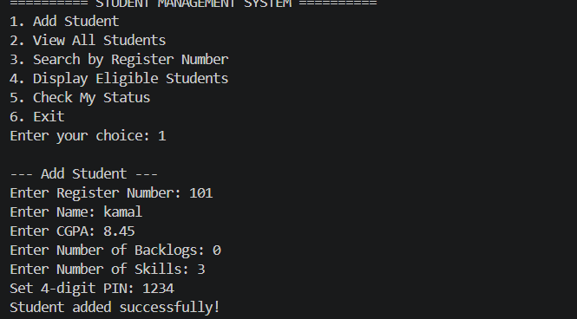
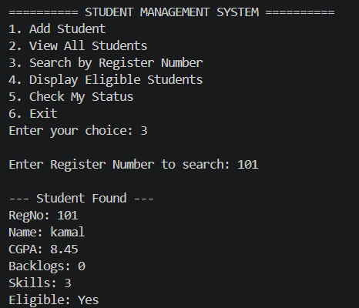
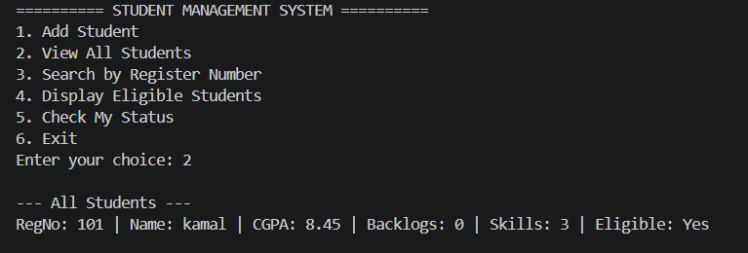
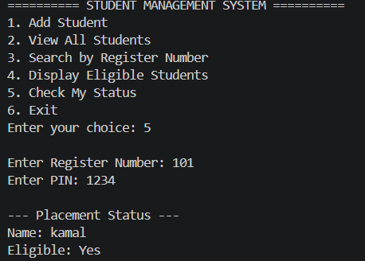
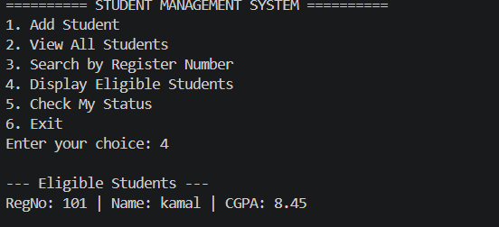
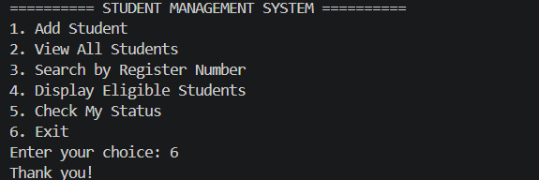
DEMONSTRATION
Program Output Walkthrough
1. Add Student
2. View All Students
3. Search by Reg. No.
4. Display Eligible Students
5. Check My Status
6. Exit
10

Slide 12



TAKEAWAYS
Key Highlights of the Project
Modular Functions
Each module is a separate, reusable function — easy to test and extend.
Thorough Input Validation
Every field is checked before use, preventing crashes from bad data.
File-Based Persistence
Records are saved to students.txt and reloaded automatically on startup.
Instant Eligibility Decisions
Status is computed automatically the moment data is entered.
11

Slide 13

Thanks for using this!
The Placement Eligibility Management System brings together structures, file handling, and validated input into one practical, menu-driven C application.
TEAM MEMBERS
Jeevan. S (811325104088)
Kamalesh. P (811325104091)
Livin Amalraj. A (811325104110)

